Slide 1
Money Management 1-2-3
1 Getting a strong start
2 Achieving financial goals
3 Planning a secure future
A project of Consumer Action | www.consumer-action.org
© 2010
Rev. 8/24
Notes:
The Money Management 1-2-3 educational module, consisting of three brochures, a corresponding PowerPoint presentation for each, and a companion lesson plan with learning activities, was created by Consumer Action, a nonprofit consumer education and advocacy organization, to be used nationwide by community-based organizations providing personal finance and consumer education in their communities.
The entire Money Management 1-2-3 curriculum can be presented as a single longer workshop or as three individual sessions. You can also customize your presentation by combining selected parts of the three sections to meet the specific needs of your group.

Slide 2
Money Management 1: Getting a strong start
Money Management 1-2-3 Getting a Strong Start
Notes:
Present the topics being covered in this presentation:
Income and taxes
Budgeting and saving
Checking and savings accounts
Establishing and building good credit
Using credit wisely

Slide 3
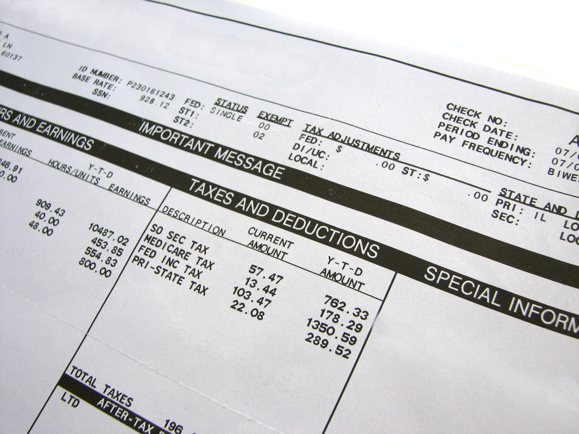
Income and taxes
Money Management 1-2-3 Getting a Strong Start
Notes:
Understanding how your income is impacted by taxes and various deductions is essential to being able to create a realistic spending and savings plan.
Net vs gross: If you receive a paycheck, you may be surprised to find that your take-home, or “net,” pay is less than what you earned (your “gross” pay) because of various deductions. Your “pay stub,” whether provided on paper or electronically, shows how much was deducted from your check for which purposes. These include mandatory deductions, for things like federal, state and local taxes and your contributions to Social Security and Medicare (FICA), as well as voluntary deductions, for things like your share of the cost of employer-sponsored health, dental and/or vision insurance and contributions to a retirement savings account and flexible spending accounts. Some voluntary contributions (such as to retirement savings and flexible spending accounts) are pre-tax, which means they are deducted from your paycheck before taxes are calculated. This lowers your taxable income and, therefore, the amount of tax you must pay. It also makes saving less painful. For example, if you are in the 22% tax bracket, every $100 you put into your 401(k) would only reduce your paycheck by about $78. Other deductions are “after tax,” meaning you must pay taxes on the income before it is deducted from your pay.
Tax withholding: Federal and state income taxes typically take the biggest bite out of earnings. How much is withheld from your check depends in part on the number of allowances (0-10) you claim on the Form W-4 your employer provides when you begin the job. The IRS form provides instructions for calculating the correct number of allowances, but it is possible to claim more or fewer, which sometimes makes sense, depending on factors such as the number of jobs you have, whether you and your spouse both work, how much you make, whether you itemize deductions, and how many dependents you have. The more allowances you claim, the less income tax is withheld. You can increase or decrease your allowances at any time by filling out a new W-4.
If too much is withheld, you’ll receive a refund when you file your tax return (between Jan. 1 and April 15 every year, unless you request an extension). A refund is nice, but it is better to have the correct amount of tax withheld from your paychecks so that you can spend or save your money throughout the year. If too little is withheld, you will have to pay the difference. If you are unable to pay what you owe, the IRS will add fees and interest to your balance.
If you don’t get a paycheck—you’re self-employed or do gig jobs—plan to put some of your earnings aside to pay taxes. If you expect to owe $1,000 or more in tax, you must make quarterly estimated tax payments (https://www.irs.gov/businesses/small-businesses-self-employed/estimated-taxes).

Slide 4
Budgeting and saving
Money Management 1-2-3 Getting a Strong Start
Notes:
A budget, or spending plan, is a way of prioritizing how you use your income. It allows you to pay for essentials (rent/mortgage, utilities, insurance, student loans, etc.), control spending on non-essentials (restaurant and take-out meals/drinks, subscriptions, etc.), save to achieve your goals (an emergency fund, a down payment, etc.), and make room for some discretionary spending (vacations, entertainment, etc.).
Essential vs non-essential spending: When allocating your income, first pay for essentials (necessities, or non-discretionary spending)—rent or mortgage, food, utilities, insurance, transportation, credit payments, etc. Second, contribute to savings for important goals, including an emergency fund that covers three to six months of living expenses. Only then should you spend on non-essentials (discretionary spending), such as dining out and recreational shopping.
Be careful about distinguishing between essential and non-essential expenses. For example, a car might be a necessity for you to get to work, but a fancy sports car is not. Food is a necessity, but daily take-out lunches are not. Clothing is a necessity, but designer boots are not. Make savings a fixed, essential expense—not something that only happens when you have money left over (which is likely to be rarely or never). Also be sure to get an accurate picture of how much you “fritter” away on small-ticket purchases, like coffee, snacks, or movie rentals.
Budgeting tools: A budget doesn’t work if it’s just in your head. Use either paper, online forms or apps (for example, Tiller, Simplifi and PocketGuard) to create and update your budget. Your budget isn’t set in stone—adjust it as needed to align your income, expenses and goals as these things fluctuate. An advantage of digital budgets (internet-based or apps) is that you can quickly and easily make adjustments without starting over, and can even experiment with different scenarios. (Learn more in The Pros and Cons of Budgeting Apps (https://www.oneazcu.com/about/financial-resources/saving-budgeting/the-pros-and-cons-of-budgeting-apps/).
Your budget should be based on monthly amounts, which means you’ll need to convert certain income and expenses. For example, divide tax refunds and quarterly or annual bonuses, as well as things like annual property taxes and subscriptions, by 12 to get the monthly amount.
If your income doesn’t cover all your wants and needs, make cuts in spending, increase income, or do a combination of both.
If you can’t make ends meet, a reputable, nonprofit credit counseling agency (www.NFCC.org or 800-388-2227) can help you asses your situation, identify options, and provide information and resources.

Slide 5
Checking and savings accounts
Money Management 1-2-3 Getting a Strong Start
Notes:
A checking account provides a place for your income to be deposited and allows you to write checks, use a debit card, or use online banking to pay bills, transfer money and monitor transactions. A good checking account is significantly less expensive, more convenient, and a better money management tool than check cashers, money orders, etc.
A savings account pays a small amount of interest and provides a safe place to keep your money until you need it. Most checking and savings accounts carry government insurance (FDIC for banks and NCUSIF for credit unions) for up to $250,000, which protects your balance if the bank or credit union fails.
Having a banking relationship with a mainstream financial institution can be valuable when you want a loan or other financial services in the future or need a reference for landlords, phone service carriers and utility companies.
Banks vs credit unions: You can set up your accounts at a bank (one with brick-and-mortar branches or online only) or a credit union. Banks are for-profit corporations. They typically offer many branches and automated teller machines (ATMs), 24/7 customer service and a variety of investment products. Credit unions are nonprofit cooperatives—in other words, they are owned by their members. They tend to have lower overhead costs because they are exempt from most taxes and do not typically pay huge executive salaries. Members benefit from these savings in the form of lower account service fees, lower interest rates and fees on credit and loans, and higher interest rates on deposits. Most credit unions are local and, therefore, tend to offer more personal service. However, not all offer as many conveniences as large banks do. Although credit unions require membership, most consumers can find one or more that they qualify to join based on location, employer, etc. (http://www.mycreditunion.gov/about-credit-unions/pages/how-to-join-a-credit-union.aspx). Locally owned and operated “community” banks may also offer some benefits similar to credit unions.
Shop around for your accounts—they’re not all the same. For example, one checking account might be better suited for someone who keeps a higher balance and writes many checks, while another might be better suited for someone who keeps a lower balance and writes few checks. Compare monthly and transaction fees, initial deposit and minimum balance requirements, interest rates, and other account terms. Websites such as Bankrate.com enable you to compare account features and costs.
Account opening requirements: Most financial institutions require two pieces of ID to open an account, one with a picture on it. If you are a non-citizen and non-permanent resident who is opening only a non-interest-bearing checking account, the financial institution might accept a consular ID card or non-U.S. passport. If you want to open an interest-bearing account but you don’t have a Social Security number, you’ll need an Individual Taxpayer Identification Number (ITIN). If one bank is not satisfied with your ID, try another one—requirements vary. If you are denied an account, ask why. It may be because your name is in the ChexSystems database, which collects information about mishandled checking and savings accounts and reports it to banks that request the information when evaluating an account applicant. You have the right to one free copy of your ChexSystems report each year or whenever your account application is rejected. Request yours at www.ChexSystems.com or call 800-428-9623.

Slide 6
Using a checking account
Money Management 1-2-3 Getting a Strong Start
Notes:
When you open a checking account, you are given an account number. This allows you to deposit money into your account. You can do this through direct deposit of your paycheck, benefits or other income (the easiest, fastest and safest way to deposit your income, and direct deposit often qualifies you for free checking), or you can make deposits by teller, ATM, mail, electronic transfer, or app (photo of the check).
To get cash from your account, you can write a check made out to yourself and take it to a teller; use the debit card that comes with the account to make a cash withdrawal at an automated teller machine (ATM) or inside a branch; or use your card with PIN to get “cash back” when making a purchase at a business, such as a grocery store, that has a "point-of-sale" (POS) machine. You can also use the money in your account by writing checks, using your Visa or Mastercard debit card wherever these credit cards are accepted, or paying bills or transferring funds in the online banking app or website.
Here are some tips for check users:
Always use a pen (not a pencil).
Never have your Social Security number or driver’s license number printed on your checks.
Don’t make a check payable to "Cash” unless you are in the presence of a teller because, if lost, anyone who finds it could cash it.
Never sign a blank check.
When reordering checks, it is probably cheaper to purchase them from a mail-order company than from your bank.
Understand what types of activities will result in an account fee, and then take steps to avoid them. For example, keep close track of your balance to avoid overdrawing your account and incurring an overdraft fee.
Check your monthly account statement as soon as it arrives to verify that all deposits, withdrawals, debits, checks and fees are accurate. Better yet, enroll in online banking, and then check your account activity frequently to verify transactions and catch any suspicious activity sooner. Reconcile your statement by following the step-by-step instructions on the statement or on the bank’s website (or at https://www.experian.com/blogs/ask-experian/how-to-reconcile-your-bank-statements/). This will help you spot errors and avoid overdrafts.
If your check was not accepted at a store, you can order a free report from Certegy (https://www.askcertegy.com or 800-237-3826) and TeleCheck (https://getassistance.telecheck.com/index/ or 800-710-9898), which are databases of returned checks.

Slide 7
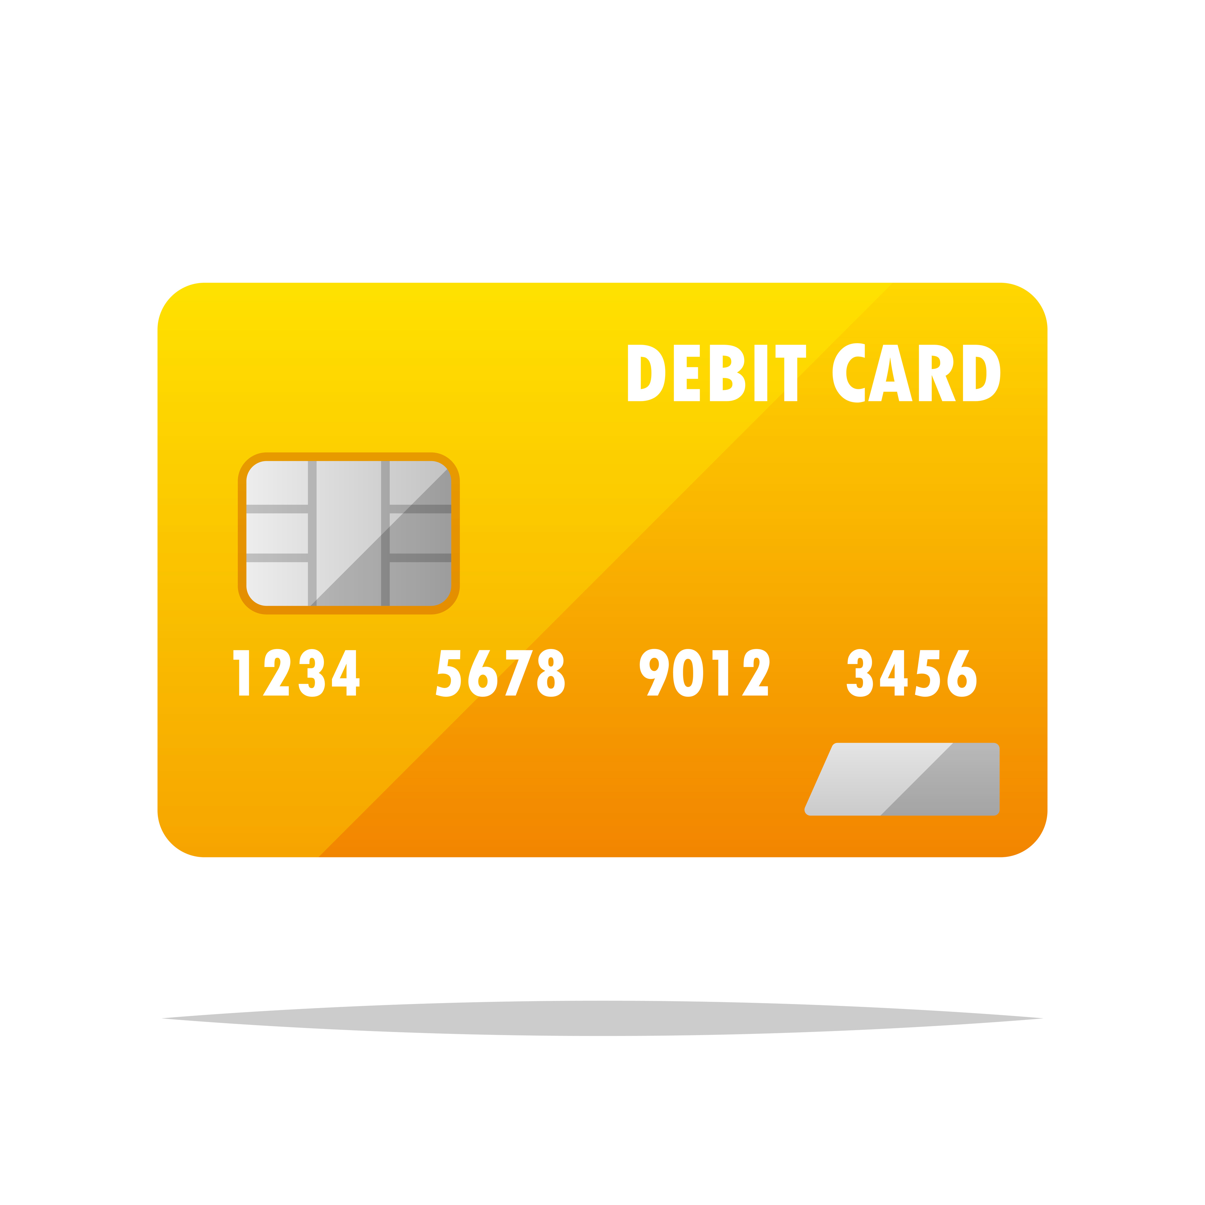
Using a debit card
Money Management 1-2-3 Getting a Strong Start
Notes:
When you open a checking account, you will receive either an ATM card or a debit card. ATM cards can be used only to conduct transactions at automated teller machines. Debit cards, which display either the Visa or Mastercard logo, can be used at ATMs as well as at businesses that accept Visa or Mastercard. However, a debit card is not a credit card. The cash you withdraw at the ATM and the money you spend with the card will be deducted directly from your account.
You can use your debit card with your personal identification number (PIN) to make cash withdrawals at an automated teller machine (ATM) or inside a branch. (Use your bank’s own ATMs or those within its network to avoid an ATM fee.) You can also use it to request “cash back” when you make a purchase at businesses such as grocery stores that have a "point-of-sale" (POS) machine (where you slide, insert or tap your card).
Your liability for transactions made with your lost or stolen debit card is only $50 if you report the loss within two business days of the time you become aware that it’s missing. If you bring the unauthorized transactions to the bank’s notice after two days but within 60 days of the statement date, your losses will be limited to $500, no matter how much money was stolen. But, you could lose all the money in your account and the unused portion of your overdraft line of credit if you fail to report an unauthorized transaction within 60 days. Sometimes it’s safer to use a credit card (if you have the option), which limits your liability for unauthorized transactions to $50 no matter when you report them. Whenever possible, use a credit card when making online purchases or when buying big-ticket items, because credit cards provide dispute rights if anything goes wrong.
When you use your debit card in situations where the final transaction amount is unknown—such as at hotels, gas stations or restaurants—the business can ask your bank to place a hold on some of the funds in your checking account. This is done to ensure that you have enough to cover the final bill when it is eventually processed. No money leaves your account until the purchase clears, but the hold is active until the transaction is settled, which could take one or more days. While the hold is in place, your available balance is reduced by that amount, which could cause checks you've written to bounce if you haven't planned ahead. If you’re concerned about a hold on your money, ask the merchant what its policy is before presenting your card.

Slide 8
Building your savings
Money Management 1-2-3 Getting a Strong Start
Notes:
Savings accounts pay interest (credit unions call it "dividends”). When shopping around for an account, compare fees and minimum balance requirements as well as interest rates. Since interest rates on savings accounts are very low, the priority when choosing a savings account should be to avoid account fees. The Bankrate (www.bankrate.com) and NerdWallet (www.nerdwallet.com) websites can help you compare fees and interest rates.
You can have separate savings accounts for each major goal, but be sure to choose accounts that don’t charge a monthly fee. Set up automatic deposits/transfers from your checking account on the day you choose (payday, for example). Note: If you are on public assistance, there may be limits to how much you are allowed to have in your savings account(s). Check with your benefits counselor.
In addition to paying a small amount of interest, savings accounts enable you to segregate your money from your checking account, so that you can’t easily spend it. But linking your checking and savings accounts makes it easier to move money between accounts. Linking is sometimes done automatically if you have your checking and savings accounts at the same financial institution. In other cases, if it’s not done automatically or if you have your accounts at different institutions, you would have to initiate the linking request.
Linking your savings account to your checking account has pros and cons (https://www.forbes.com/advisor/banking/is-it-safe-to-link-bank-accounts/). On the one hand, your savings account may serve as a less expensive overdraft protection plan should you inadvertently overdraw your checking account (if you opt in to the service, money can be transferred to checking to cover an overdraft, allowing you to avoid an overdraft fee—though you still may be charged a lower transfer service fee), and it may help you meet a combined balance requirement that qualifies you for free checking. On the other hand, it makes it easier and more tempting to tap the money to for routine expenses or impulse purchases.
IDAs: Individual development accounts (IDAs) are sponsored savings accounts that help low-income families build savings. Contributions are matched by private and public institutions. Most participants in IDAs also take part in mandatory money management classes. Learn more (https://prosperitynow.org/sites/default/files/resources/IDA_Fact_Sheet_2009_12_12.pdf) and find local IDA programs (https://prosperitynow.org/map/idas). There may be other sponsored savings programs—ask your community bank or credit union.
Note: Additional savings vehicles, as well as investing options, are discussed in Part 2 of the Money Management 1-2-3 module.

Slide 9
Establishing and building good credit
Good credit enables you to:
Get approved for a home rental, insurance, utilities, wireless service, or employment
Qualify for credit, loans and financing
Get favorable financing terms (interest rates)
Handle emergencies
Money Management 1-2-3 Getting a Strong Start
Notes:
Good credit is a strong financial tool. Without good credit, it can be difficult to rent a home, get insurance, set up utility service, or even get a cell phone. Some employers reject job applicants with bad credit. If you are unable to qualify for loans and financing, it may be impossible to achieve financial goals such as buying a home or starting a business. If you do manage to get credit without a good credit history, it will cost you much more than borrowers with good credit pay. Good credit also means you have more options for dealing with a financial emergency.
Because it can take time to establish and build a strong credit history, it’s wise to begin the process even if you don’t need credit right away.

Slide 10
Financial cost of bad credit
60-month new car loan of $25,000
Credit score: 650 725
Interest rate*: 9.62% 6.83%
Monthly payment: $527 $493
Total interest paid: $6,591 $4,582
Cost of a low credit score: $2,009
(more than $400/year additional interest!)
*https://www.bankrate.com/loans/auto-loans/average-car-loan-interest-rates-by-credit-score/#score (on 8/15/24)
Money Management 1-2-3 Getting a Strong Start
Notes:
Your credit rating is expressed as a three-digit number—your credit score—that reflects the information in your credit report. Your credit report is a compilation of a variety of data, including identifying information (your name, address, etc.); credit use information (your payment history, outstanding balances, credit limits on revolving accounts, the date each account was opened, and the current status of your own accounts as well as accounts you have cosigned or on which you are an authorized user); and information from public records (bankruptcy filings, liens against you, etc). There are three major credit bureaus that compile credit reports: Experian, TransUnion and Equifax.
Your credit score is intended to tell lenders, at a glance, how likely you are to repay money you’ve borrowed, based on how you’ve handled credit and bills in the past. The higher your credit score, the lower a risk you are perceived to be by the lender, and the lower your interest rate on loans and credit you apply for.
Even a small difference in the rate on an auto or home loan can mean a savings of hundreds or thousands of dollars in finance charges over the life of the loan. Note how the first borrower, with a score of 650, must pay a much higher interest rate than the second borrower has to pay, and that his monthly payment is $34 higher. A good credit score not only qualifies you for more credit opportunities, it qualifies you for better credit opportunities.
Rate information: https://www.bankrate.com/loans/auto-loans/average-car-loan-interest-rates-by-credit-score/#score (on 8/15/24)
Calculator: https://www.bankrate.com/loans/auto-loans/auto-loan-calculator/

Slide 11
Credit score calculation
30%
Money Management 1-2-3 Getting a Strong Start
Notes:
The two most widely used credit scoring models are the FICO score and the VantageScore (though there are others used by different businesses for different purposes).
FICO calculates scores based on five categories:
Payment history (35%): Whether or not you’ve paid your bills on time in the past
Amounts owed (30%): The total amount of money you have borrowed as compared to the total amount you are allowed to borrow (credit utilization)
Length of credit history (15%): How long you’ve had your accounts (the longer, the better)
Types of credit (10%): The mix of credit accounts, such as mortgages, retail accounts and credit cards (experience managing both revolving credit and installment loans well can raise your score)
New credit (10%): Multiple recently opened accounts represent higher risk
Source: http://www.myfico.com/crediteducation/whatsinyourscore.aspx
VantageScore calculates scores based on four categories:
Payment history (40%)
Amounts owed (34%)
Credit mix (21%)
New credit (5%)
(These percentages may vary slightly depending on which version of VantageScore is being used.)
Source: https://www.vantagescore.com/press_releases/the-complete-guide-to-your-vantagescore/
Information about how your credit score is calculated is useful to help you maintain your good credit going forward. For example, regardless of which scoring model is used, your payment history and outstanding debt will have the greatest bearing on your scores—something to be aware of as you manage your debt payments and take on new credit obligations.
Both FICO and VantageScore use a 300 to 850 scale.
FICO:
Exceptional credit = 800+
Very good credit = 740-799
Good credit = 670-739
Fair credit = 580-669
Poor credit = below 580
Source: https://www.myfico.com/credit-education/what-is-a-fico-score
VantageScore:
Super prime = 781+
Prime = 661-780
Near prime = 601-660
Fair credit = 580-669
Subprime/Not prime = 300-600
Source: https://www.experian.com/blogs/ask-experian/what-is-a-vantagescore-credit-score/
The average consumer has multiple different credit scores because, in addition to there being different scoring models, there are three different credit bureaus (Equifax, Experian and TransUnion), and each one is likely to have slightly different data on any consumer. However, someone with good credit according to one credit bureau or scoring model should have good credit across the board. Likewise, someone with a low credit score according to one model is likely to have low scores on all scales.
Be sure to check your credit reports (https://www.consumerfinance.gov/ask-cfpb/how-do-i-get-a-free-copy-of-my-credit-reports-en-5/) regularly to catch any errors and to know where you stand. You can get one free credit report every 12 months from each of the three major credit bureaus (Equifax, Experian and TransUnion) at https://www.annualcreditreport.com or 877-322-8228. And, since the pandemic, consumers have been able to view free weekly reports online.
Typically, your free credit reports do not include your score, but there are many sources of free credit scores, including major credit card issuers, banks, lenders, nonprofit credit counseling agencies, and credit card comparison websites, such as CreditKarma.com, Credit.com and CreditSesame.com. If you can’t get a free score through any of these sources, you can purchase your FICO score at myFICO.com and you can purchase your VantageScore at AnnualCreditReport.com and at the Equifax, Experian and TransUnion websites.
Beware of offers of “free” credit scores that enroll you in a monthly fee-based credit monitoring service. Also beware of “credit repair” services, which promise to improve your credit reports/scores. Other than improving your credit over time by using credit wisely, the only way to improve your credit report or score is by correcting errors or getting outdated derogatory information off your report—both of which are things you can do yourself for free.

Slide 12
How to build credit
Open a credit account
Be an authorized user
Have a cosigner
Get a secured card
Get a credit-builder loan
Report non-credit payments
Repair mistakes
Use credit wisely
Money Management 1-2-3 Getting a Strong Start
Notes:
In order to build a positive credit history, you must first obtain credit. Some ways to do that are:
Open a credit account. It might be easier to get credit through a small local bank or a credit union, or to get a department store card or gas card rather than a Visa, Mastercard, American Express or Discover card.
Become an authorized user on someone else’s account—but only if they have good credit. If they’re concerned you might rack up debt in their name, you could offer not to have the account information/card in your possession.
Have someone cosign a loan or credit line for you. However, if you don’t make payments as promised, your cosigner’s credit will be damaged and he or she will be responsible for the debt.
Get a secured credit card, which requires you to put down a cash deposit that serves as collateral for the small credit line until the card company upgrades you to a traditional “unsecured” card (if you have paid your bills on time) and refunds the deposit (https://www.nerdwallet.com/article/credit-cards/secured-credit-cards-vs-unsecured-difference).
Ask your bank or credit union about products (such as credit-builder loans) or suggestions for establishing credit (https://www.nerdwallet.com/article/loans/personal-loans/what-is-credit-builder-loan).
Report recurring non-credit payments such as rent and/or utilities to reporting services that track this information for those who have not yet established credit, or ask those you make payments to if they can report on your behalf. (Learn more here: https://www.nerdwallet.com/article/finance/rent-reporting-services) and here (https://upsolve.org/learn/self-reporting-to-the-credit-bureaus/.)
Repair past-due accounts and/or correct inaccurate derogatory (negative) information in your credit reports. (Get your free credit reports once every 12 months at www.AnnualCreditReport.com, or check them online more frequently, so that you can catch any errors). Do not fall prey to credit repair scams that promise to remove derogatory (negative) information from your report for a fee. You can do anything these companies can do at no cost. Only discipline and time can repair damaged credit.
Here are some tips for managing your credit so that it works for you rather than against you:
Make at least the required minimum payment by the due date. Pay more than the minimum whenever possible.
Pay your balance in full as soon as possible. This not only helps you avoid interest charges, it reduces the percentage of available credit used, which improves your credit score. Make a point of not using more than 30% of each credit line. (Example: It’s better to use $300 on each of two credit cards with limits of $1,000 than to use $600 on one of those cards.)
Don’t accumulate debt. The more debt you carry, the riskier you look to lenders, and the lower your credit score.
Don’t apply for credit you don’t need unless you are trying to establish credit.
Contact a credit counselor if you’re having money troubles (www.NFCC.org). A nonprofit credit counseling agency can help you revise your budget, get out of debt and understand your rights.

Slide 13
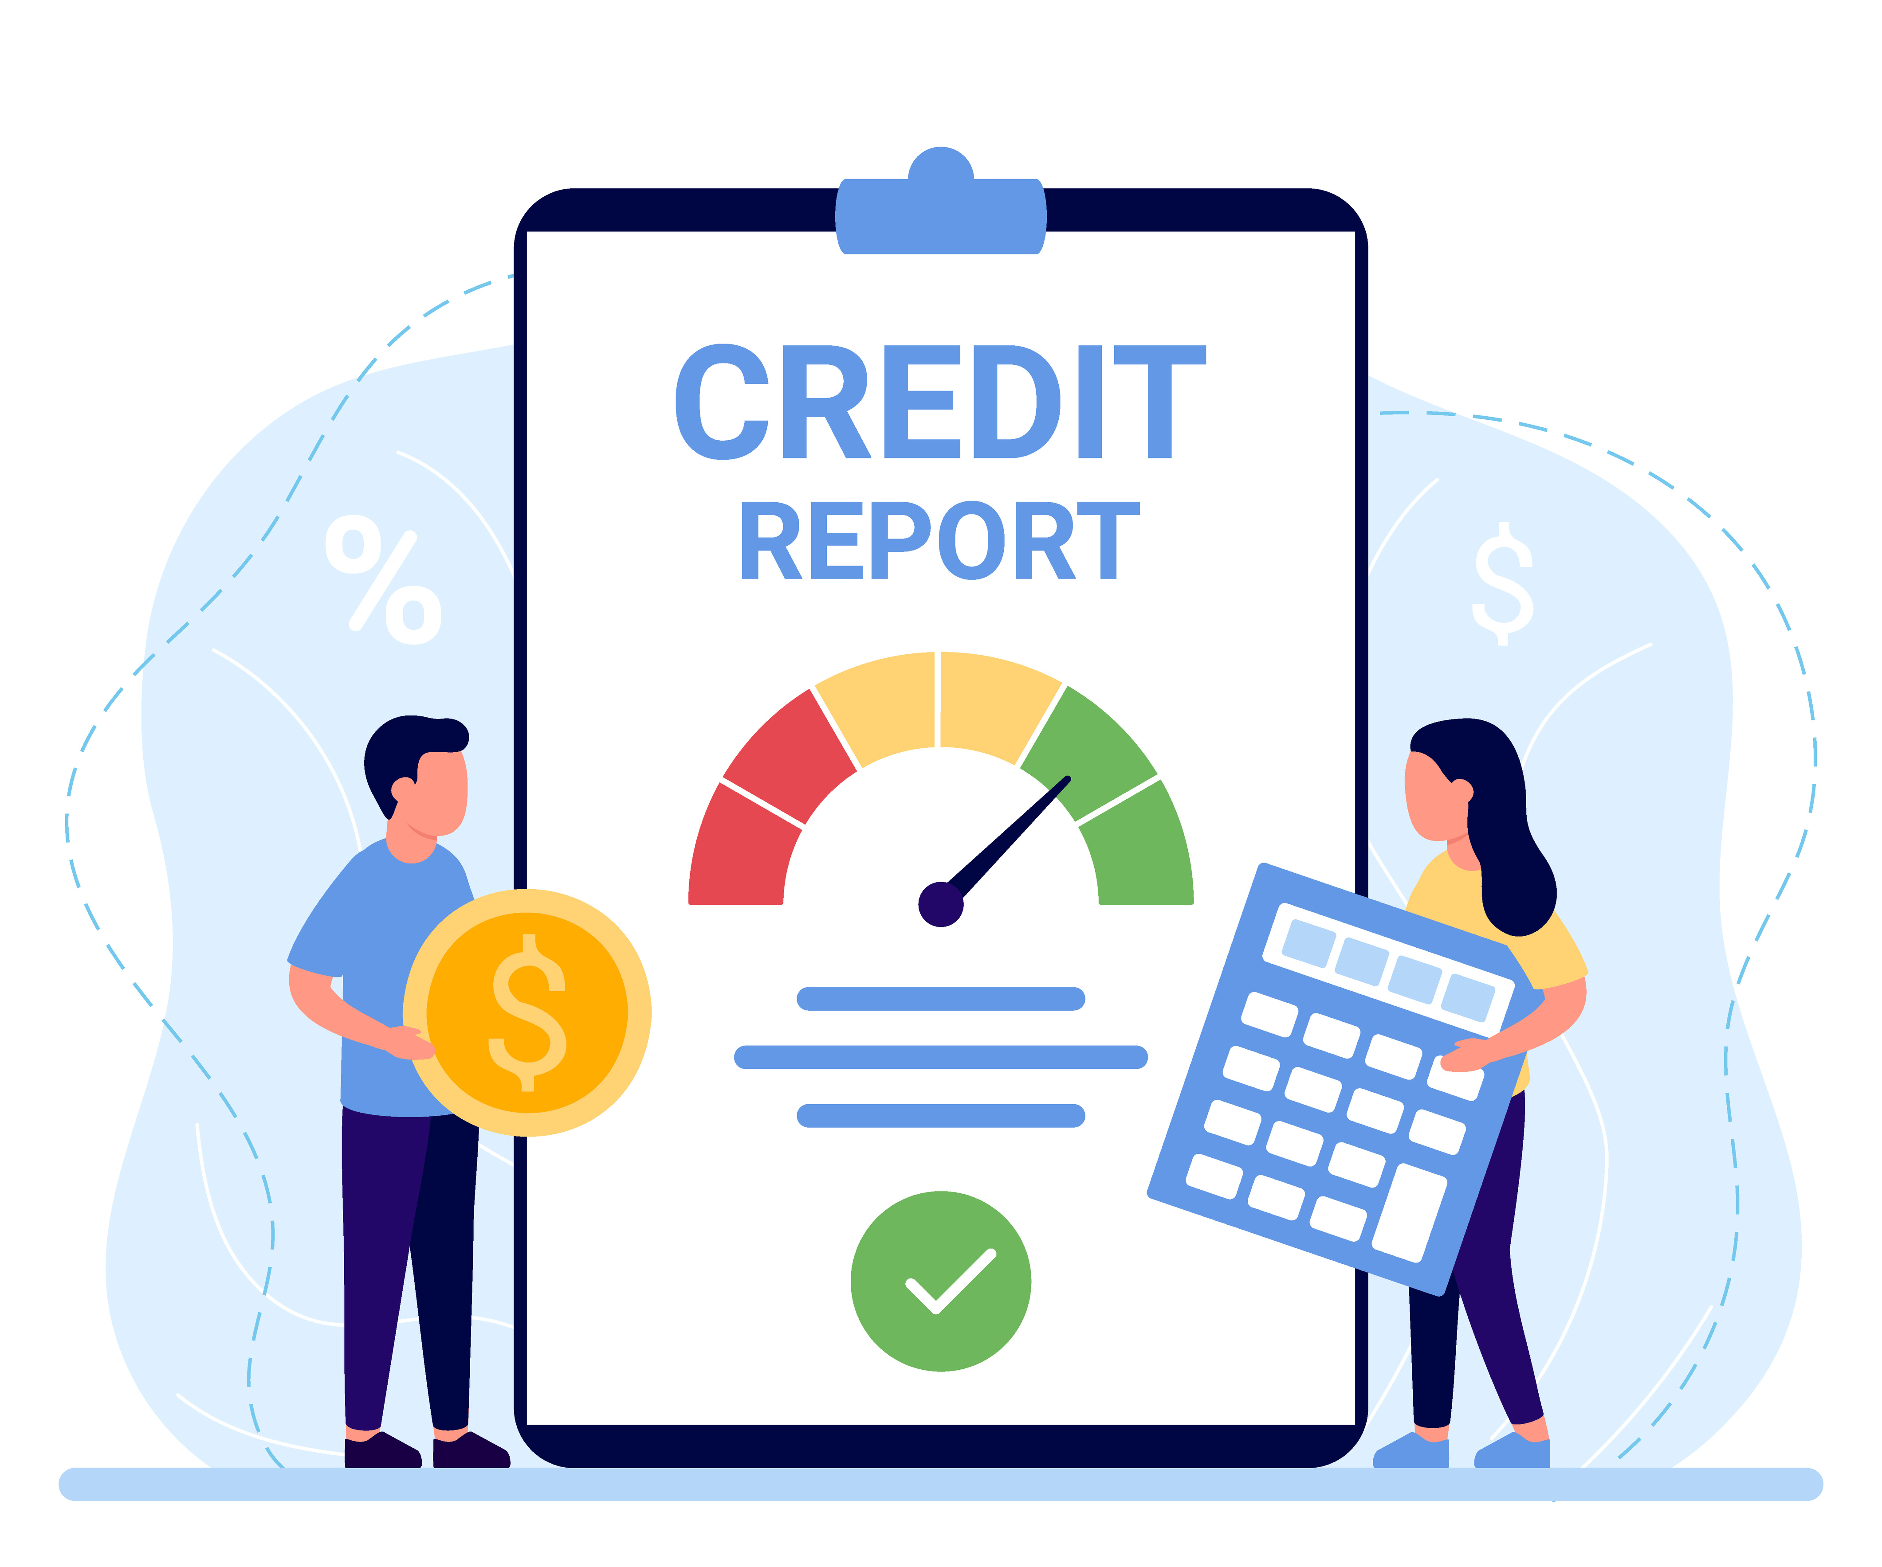
Using credit wisely
Installment vs. revolving
Interest rate (APR) and type (fixed/variable)
Repayment term (length of credit)
Fees
Money Management 1-2-3 Getting a Strong Start
Notes:
There are two types of credit: installment and revolving.
Installment credit requires you to make fixed monthly payments until you repay the full loan amount. Once you reach a zero balance, the account is closed. Car loans, home mortgages and student loans are examples of installment credit. In some cases (like auto and home loans), the loan is secured by the property you purchased with the borrowed money (the collateral). If you default on the loan (don’t repay it), the lender can repossess (take back) the item or property you financed. (In the case of a home, this is a foreclosure.) Not all installment credit is secured; student loans are an example of unsecured installment credit.
Revolving credit—credit cards and lines of credit—allows you to borrow money over and over again, up to your “credit limit,” which is determined by the credit issuer and is based on factors such as your credit score. You can use the credit line up to the assigned limit. The amount of your available credit fluctuates as you use part of the credit line and then repay it. Your payments will fluctuate based on the outstanding balance and the interest rate, which typically fluctuates. You have the option to pay the entire balance when the bill is due or to pay a part of it (at least the required ”minimum payment due”) and carry over the remainder to the following month. You can avoid finance charges by paying off the entire balance each month. A zero balance does not close the account.
Interest: Interest is what you pay someone to use their money. It is expressed as a percentage of the loan or outstanding credit amount. The annual percentage rate (APR) takes into account certain loan fees (such as “points” paid on a home equity loan). Interest can be fixed (the rate stays the same throughout the life of the loan) or variable (the rate fluctuates based on economic conditions). It is very important to know what interest rate you are being charged, what the true cost of the loan is (APR) and whether it (and your payments) can fluctuate before you accept the loan/credit offer.
Repayment term: The “term” is the period over which you are expected to repay an installment loan. The longer the term, the lower the monthly payments, but the more total interest you will pay over the life of the loan. (Example: A $10,000 loan for three years at 8% interest would cost you $313.36 per month and you would pay $1,281.09 in interest over the life of the loan. The same loan with a term of five years would cost you only $202.76 per month, but you would pay $2,165.84 in interest over the life of the loan.)
Fees: Fees can include things like an application fee, a credit report fee and/or an annual fee (typical on some “charge” cards, such as American Express). It’s important to know exactly what fees will be charged, as well as the interest rate. You can use the APR to make an apples-to-apples comparison of loan/credit options.
The Truth in Lending Act gives you the right to upfront disclosure of all credit terms and costs (https://finred.usalearning.gov/assets/downloads/FINRED-TruthLendingAct-FS.pdf).

Slide 14
Money Management 1-2-3 Getting a Strong Start
Notes:
Some loan products are a bad deal for borrowers. They may have consumer-unfriendly terms, such as exorbitant interest rates, very high fees, and unaffordable payments, or there is a high risk of repossession of property put up as collateral that is worth far more than the credit extended. These types of loans are often described as “wealth-stripping” because consumers who use them pay an inordinately high proportion of their income on fees and finance charges, and risk losing their only assets if they use them as collateral. Because the loans are often granted without regard to the borrower’s ability to repay and are readily refinanced along with additional fees, they tend to facilitate a cycle of increasing indebtedness that is difficult or impossible to break. These wealth-stripping loans include:
Payday loans: These small-dollar loans typically must be repaid the next payday via a post-dated check or bank account debit authorization that includes principal, interest and fees. Many borrowers must refinance the loan one or more times, incurring more fees and interest and making it increasingly difficult to pay off the debt and end the cycle.
Vehicle title loans: Auto title loans require you to give the lender the title to your vehicle as collateral. If you can’t repay the loan, including fees and interest, by the due date, you must renew the loan, if that is an option, or forfeit the vehicle. Typically, the collateral for a vehicle title or pawnshop loan is worth much more than the amount of the loan, resulting in a very damaging loss if you can’t make the payments as agreed.
Pawnshop loans: These are similar to vehicle title loans, except the collateral—typically assets such as jewelry, electronics, computers, musical instruments and family heirlooms—is different, and you don’t get to keep using it while the loan is outstanding. If the loan is not repaid, the lender can sell your personal property and keep the proceeds.
Subprime auto loans: Subprime auto loans can come from an independent lender or from the auto seller. Regardless of the source, these loans have very high interest rates. In the case of “Buy here, pay here” car lots, the unaffordable loans often result in repossession of the financed vehicle.
Mortgages w/balloon or interest-only payments: A balloon payment is a lump-sum pay-off of the remaining loan balance. Some loans are designed to require a balloon payment after a few years of interest-only payments. If you can’t come up with the single, large sum when it’s due, the lender will most likely foreclose on the property (take your home). If you haven’t built enough—or any—equity in the home while you’ve been making payments (because the payments didn’t include principal and/or the property didn’t appreciate significantly), you will not be able to sell it or refinance it to pay off the loan.

Slide 15
Payment cards
Credit
Prepaid
Debit
Money Management 1-2-3 Getting a Strong Start
Notes:
As you work to establish and build credit, it’s important to understand how different types of payment cards do or don’t help you achieve that goal, and know the other pros and cons of each.
Credit cards:
Can help you establish and build a good credit history if they are managed responsibly
Provide the best protection against fraud, unsatisfactory/undelivered merchandise and billing errors
Make it possible to shop online, buy airline tickets, rent a car, reserve a hotel room, use ride—sharing services, etc.
Function as an interest-free loan if you pay your balance in full when the bill is due and you have not carried a balance over from the previous month (grace period)
Make it easier to deal with some emergencies, since you have the option to pay over time
May offer rebates/rewards
But, credit cards also:
May encourage you to spend more than you can afford
Make purchases more expensive if you accrue interest charges
Are a relatively expensive form of credit (high interest rates, high potential fees, immediate interest on cash advances, etc.)
Have the potential to redirect future income away from savings and into debt payments—in some cases, indefinitely
Could lead to judgments, wage garnishment or bankruptcy if you cannot pay the monthly bills
Debit cards:
Provide a payment card option even if you can’t obtain a credit card
Don’t enable you to accumulate debt
But, debit cards also:
Won’t help you establish or build credit
Don’t give you flexibility to spend more than what is in your account to cover an emergency, and don’t let you pay over time
Can result in fees if you try to spend more than your account balance
Are not as safe as a credit card in the case of fraudulent use or unsatisfactory/damaged/undelivered merchandise, and could result in your account being temporarily drained by someone who finds or steals your card
Could make it more difficult to get a refund on a returned purchase since a debit card transaction is treated as a cash transaction
Prepaid cards:
Are easy to get—generally speaking, if you have the money to load onto the card, you can get one
Offer the convenience of plastic (ability to shop online, etc.) even if you can’t get (or don’t want) a credit card and/or checking account debit card
Don’t enable you to accumulate debt
May offer some protections against loss or unauthorized use
But, prepaid cards also:
Won’t help you establish or build credit
May cost more in fees than a credit or debit card
May leave you helpless if you have an emergency expense that exceeds the balance on the card

Slide 16
Financing a vehicle
Money Management 1-2-3 Getting a Strong Start
Notes:
For many people, a car is the largest expenditure they ever make, or the largest before someday buying a home. Because a car is such a major purchase, many buyers must get financing rather than pay cash. If you need a loan, it’s important to know your financing options before you commit to a loan and understand how to avoid an unaffordable loan or one with consumer-unfriendly terms.
Loan sources: Car loans come from a variety of sources: credit unions, banks, online direct lenders, auto finance companies and brokers, and auto manufacturers (through “dealer financing”). The rates and terms you get from each of these sources can vary widely, so you should determine your options before you even walk onto a car lot. That way you can know how other loans compare to the one the dealer offers you. Since any lender will base loan terms on your credit score, you should obtain your credit report (at AnnualCreditReport.com) to make sure there are no errors or outdated items that could result in a lower score. If possible, also obtain your credit score so that you know where you stand and can be on guard for unscrupulous dealers claiming your credit is worse than it is just to justify a higher interest rate.
Interest rates: Dealers often advertise 0% and other attractive interest rates. However, only people with the best credit can qualify for the best financing. Check the Bankrate.com website (https://www.bankrate.com/loans/auto-loans/rates/) to find a sampling of current auto loan rates and to get an idea of what rate your credit score qualifies you for. It’s a good idea to get preapproved for a loan from a non-dealer source—credit union, bank, etc.—before visiting a dealership. That way you have another option available to you if the dealer offers less favorable terms. If the lender you get your financing from requires a co-signer on the loan, be aware that your co-signer is responsible for repaying the loan if you can’t.
Loan term (length): The auto loan repayment period (loan term) has typically been 36 months (three years), 48 months (four years) or 60 months (five years). Today, however, there are loans with six-year or longer terms. You can lower your monthly payments by choosing a longer loan period. However, the longer the term, the more total interest you will pay over the life of the loan. Also, when you have a very long loan term, you risk the chance of still owing on your current car when you are ready to purchase your next one.
What you can afford: Free online calculators, such as the one offered by Bankrate.com (https://www.bankrate.com/loans/auto-loans/auto-loan-calculator/), can help you determine how much you can afford to borrow and how different interest rates and loan terms will affect your monthly payment. It is easy to be tempted by a shiny car and a smooth-talking dealer, so set your budget before you start shopping, and stick to it.
What to avoid: 1) Most auto finance companies that work with dealers let them mark up the interest rate to the consumer and keep the difference or a portion of it. The best way to avoid a dealer markup is to determine your credit rating and what interest rates you would qualify for with an online lender, bank or credit union before visiting dealerships. Armed with this knowledge, you will be in a stronger position to negotiate the best deal (the markup is negotiable). 2) Some dealers allow you to drive off the lot in your new car without the financing being fully approved. They then call you back and say that your loan was denied at the quoted rate and you’ll need to either pay a higher rate or bring the car back (if you won’t pay the new rate or your loan application was rejected entirely). To avoid this, make sure your financing has been fully approved before signing a contract and leaving with the vehicle. 3) Loan-packing is what it’s referred to when a dealer adds “after-market” extras—rustproofing, a security system, VIN etching, gap insurance, tire protection and extended warranties, for example—to increase the cost of the vehicle or the amount of the loan. Although the add-on(s) might increase your monthly payment only a small amount, the total cost over the life of the loan can be much more than the add-on is worth. Only buy what you really need, and ask yourself if the purchase would be as attractive if you had to pay cash for it on the spot. 4) Beware of “Buy here, pay here” auto dealers, who typically sell and finance used autos in-house for consumers with poor or no credit. The interest rates are very high, the terms are sometimes difficult to fulfill, and the seller repossesses the vehicle (and resells it) as soon as the borrower defaults. It’s best to avoid these dealerships.

Slide 17
Congratulations!
You’ve completed Part 1 of the
Money Management 1-2-3 training.
Money Management 1-2-3 Getting a Strong Start
Notes:
Thank participants for attending. Ask them to take a few minutes to fill out the evaluation form that is in their folders and leave it in a large envelope you provide or face down on a table.

